Slide 1
PROJECT WORK - 1
(FINAL REVIEW)
Presented by,
Manjusha S 21Z317
Mydhili Nayaki R 21Z324
Shrinidhi S 21Z352
Swetha M 21Z362
Vedavarshini A 21Z368

Slide 2

AGENDA
Title
Problem Statement
Design and Implementation
System Architecture
Results - Performance Metrics
Results - Plots
Optimization module

Slide 3

SOIL HEAT FLUX DYNAMICS MODELLING USING TEMPORAL DEEP LEARNING FOR DETERMINING PLANT ROOT ZONE TEMPERATURE

Slide 4

ABSTRACT
Aims to address the critical challenge of accurately predicting soil heat flux dynamics, which directly impact plant root zone temperature and overall agricultural productivity.
Employs Temporal Convolutional Networks (TCNs), a state-of-the-art deep learning architecture designed for temporal sequence data analysis.

Slide 5

PROBLEM STATEMENT
Productivity of Indian agriculture is often hampered by suboptimal soil temperature regulation, particularly in the root zone of plants.
Inadequate root zone temperature control can lead to poor plant health, reduced crop yields and increased vulnerability to pests and diseases.
Soil heat flux governs the transfer of energy within the soil.
Need for handling sequential data and capturing complex temporal patterns.

Slide 6
OBJECTIVE
By leveraging TCNs, this project aims to develop a robust predictive model that can dynamically forecast soil heat flux and optimize root zone temperature.
This advancement is expected to significantly improve agricultural productivity and sustainability in India, aligning with the nation's goals for food security and economic growth.

Slide 7
Design and Implementation - Progress till Review 3
425,262 entries and finding attributes types
Resampling the Time Series dataset in an interval of 10 minutes to augment the number of data points in the training, testing, and validation sets.
10 columns have missing values , Contains extreme values like -9999, needs cleaning and entries are 0, should be deleted
Constant negative soil heat flux, with occasional sharp spikes to positive values.
Scale data using Min-Max Scaler, drop columns with all zero values
Recommended features: Volume 20cm, Volume 10cm, Net Radiation, Conductivity, Soil Temperatures (10cm, 20cm, 80cm), DateTime/Month
Data was divided into four intervals based on time (Night, Morning, Afternoon, and Evening) for better analysis of temperature patterns across different parts of the day.
RZT values were optimized using Bayesian optimization with Gaussian Process minimization, targeting an ideal temperature of 25°C
Highest Accuracy of 99.44% is achieved at threshold ±3.450°C.

Slide 8
Design and Implementation - Progress after Review 2
Soil temperatures at depths of 10 cm, 20 cm, 40 cm, and 80 cm were weighted using an exponential decay formula. This was based on the assumption that shallower depths have a larger influence on RZT. The weighted sum of soil temperatures was computed, yielding the RZT for each timestamp.
Time-of-Day Segmentation: Data was divided into four intervals based on time (Night, Morning, Afternoon, and Evening) for better analysis of temperature patterns across different parts of the day.
Optimization Setup: The RZT values were optimized using Bayesian optimization with Gaussian Process minimization, targeting an ideal temperature of 25°C. The optimization process aimed to minimize deviations from this ideal temperature, accounting for penalties if the RZT exceeded or fell below acceptable limits.

Slide 9
SYSTEM ARCHITECTURE

Slide 10
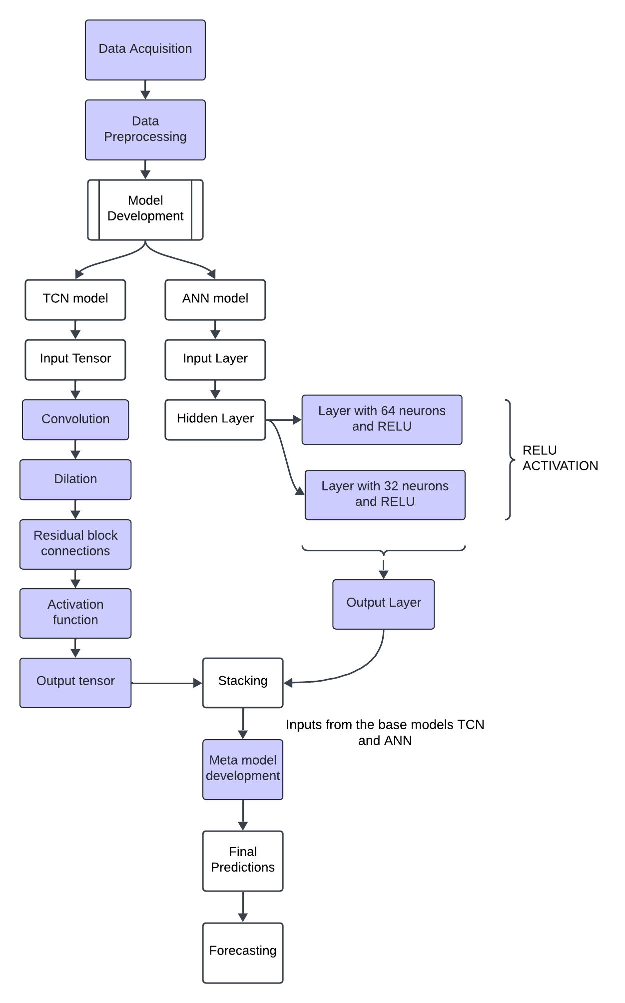
BASIC FLOW OF THE ENSEMBLE MODEL

Slide 11
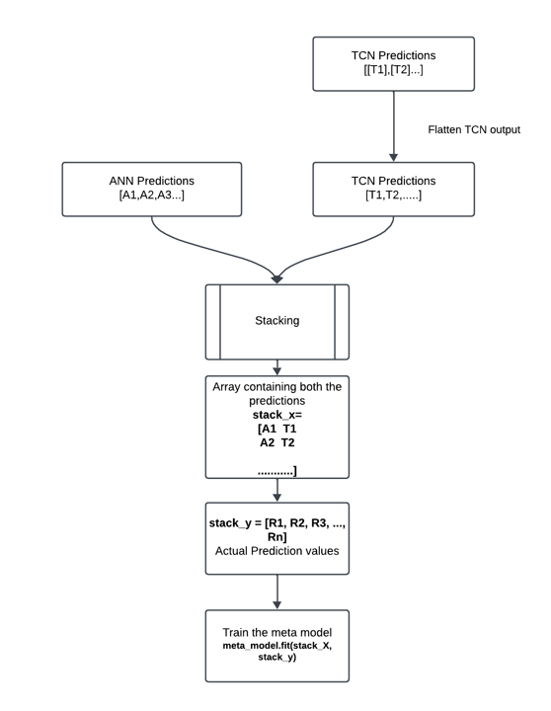
STACKING IN ENSEMBLING

Slide 12
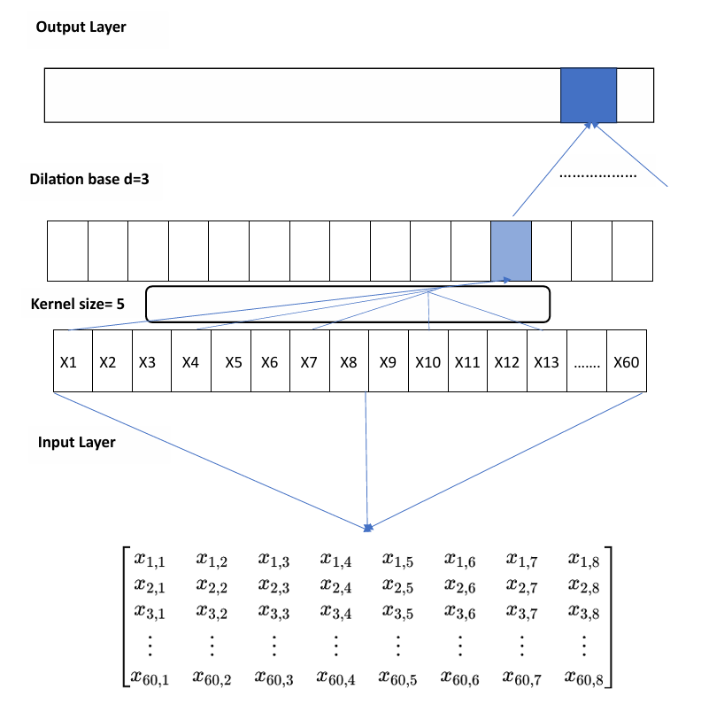
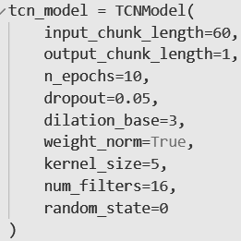
Architecture of TCN And ANN - Ensemble model
TCN
Architecture
(60,8)
input_chunk_length=60
Features=8

Slide 13
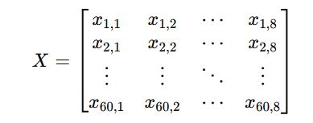



Mathematical representation of TCN
Input representation
2. Convolution Operation
3. Dropout Application
4. Output layer calculation

Slide 14
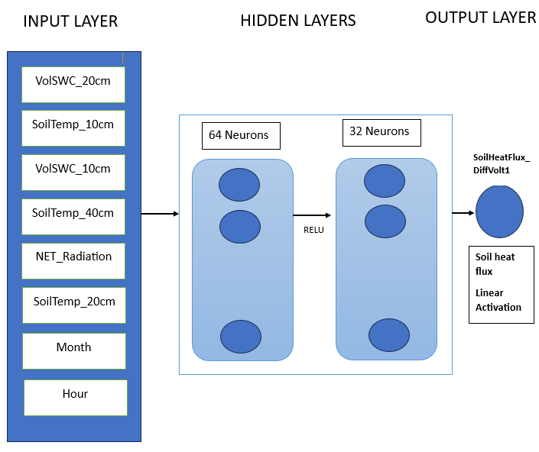






ANN Architecture

Slide 15
RESULTS - PERFORMANCE METRICS

Slide 16
Performance metrics
MSE
Epochs | ANN | TCN | LSTM | TCN + ANN
100 | 0.2885 | 3.9944 | 4.6438 | 0.1713
75 | 0.3060 | 9.1605 | 10.297 | 0.1729
50 | 0.4318 | 3.4131 | 6.314 | 0.1559
25 | 0.3305 | 3.7179 | 5.7047 | 0.1563
10 | 0.4456 | 3.7188 | 5.1142 | 0.1468
MAE
Epochs | ANN | TCN | LSTM | TCN+ANN
100 | 0.4124 | 1.4298 | 1.9296 | 0.2901
75 | 0.4151 | 2.4254 | 2.8705 | 0.2866
50 | 0.4226 | 1.3366 | 1.9662 | 0.2935
25 | 0.4664 | 1.3659 | 1.8584 | 0.2948
10 | 0.4778 | 1.3498 | 1.6724 | 0.2834

Slide 17
Performance metrics
R^2 (%)
Epochs | ANN | TCN | LSTM | TCN+ANN
100 | 93.56 | -0.3619 | -0.5833 | 94.16
75 | 85.26 | -3.1234 | -2.5109 | 94.10
50 | 90.97 | -0.1637 | -1.1528 | 94.69
25 | 92.70 | -0.2676 | -0.9451 | 94.67
10 | 91.09 | -0.2679 | -0.7437 | 93.57

Slide 18
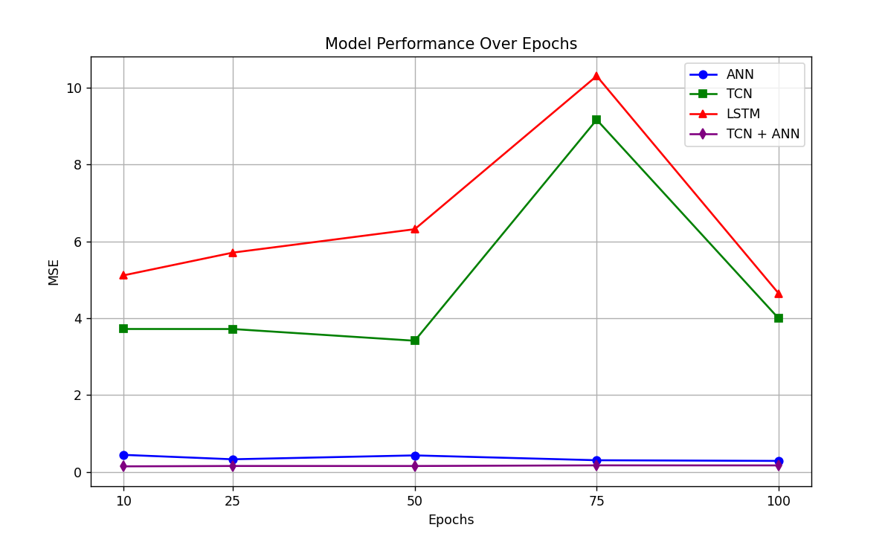

Slide 19
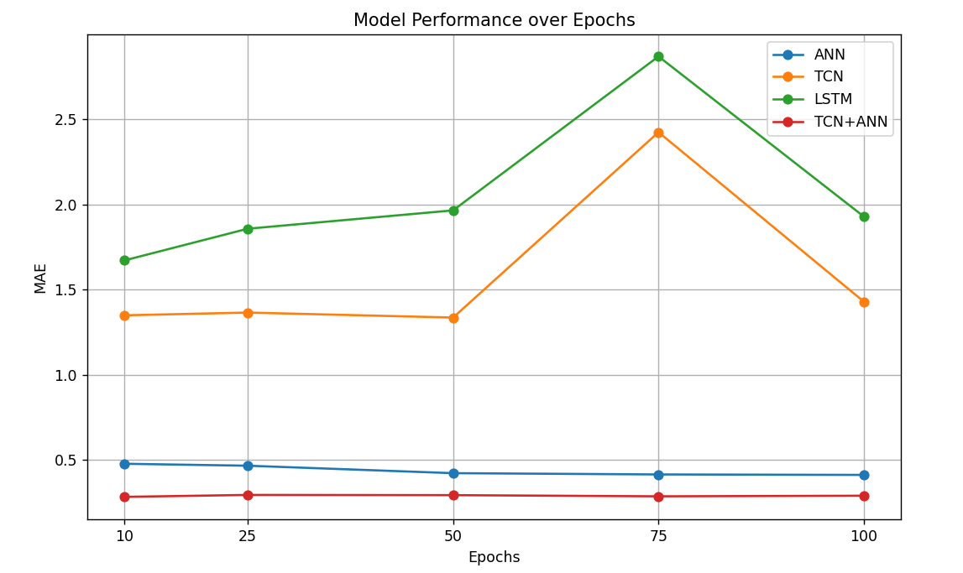

Slide 20
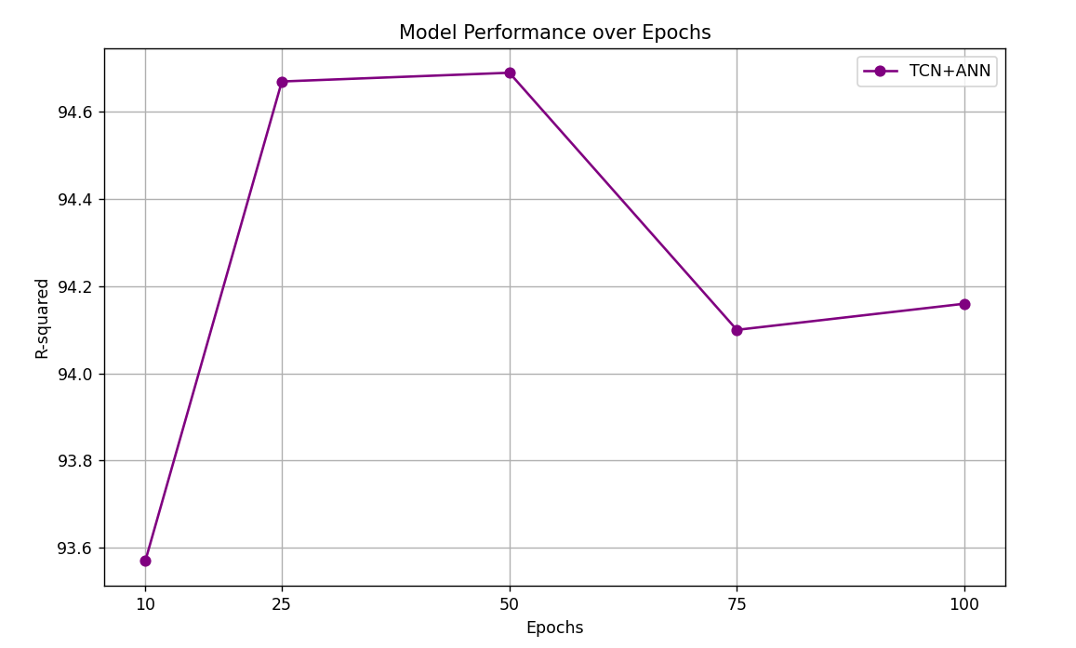

Slide 21
RESULTS - PLOTS

Slide 22
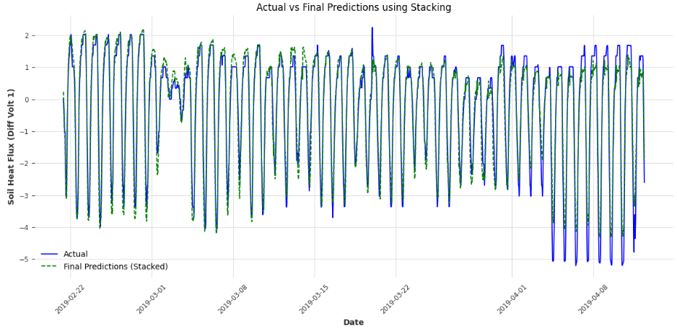
TCN+ANN Predictions
Test set

Slide 23
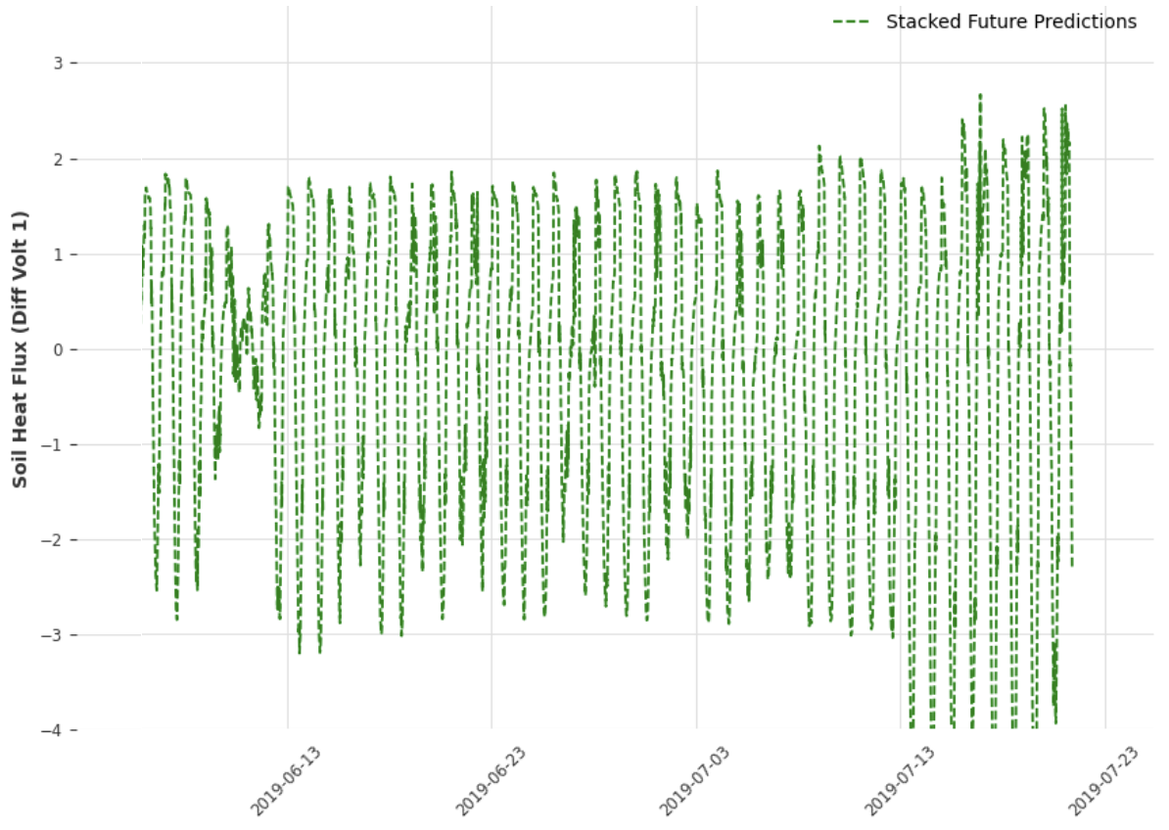
Forecasting

Slide 24
OPTIMIZATION MODULE

Slide 25
COMPARISON OF OPTIMIZATION TECHNIQUES
RIDGE REGRESSION
Ridge Regression is used to model a linear relationship between soil temperature data and root zone temperature.
It helps in creating a more stable model by adding a constraint (or penalty)
This penalty prevents the model from focusing too much on less important fluctuations in soil temperature, ensuring that the predictions are not overly sensitive to minor variations.
Ridge Regression has its limitations—it only captures linear relationships, which might not fully reflect the complex dynamics of root zone temperature.

Slide 26
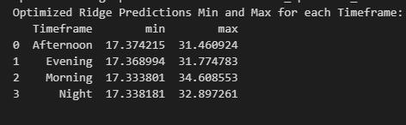
COMPARISON OF OPTIMIZATION TECHNIQUES
RIDGE REGRESSION

Slide 27
COMPARISON OF OPTIMIZATION TECHNIQUES
GRADIENT BOOSTING REGRESSION
Load Data: Import libraries and read CSV, setting DateTime as index.
Categorize Timeframes: Classify data into Night, Morning, Afternoon, and Evening.
Separate Features and Target: Isolate numerical features from the target variable (RZT).
Split Dataset: Divide data into training (80%) and testing (20%) sets.
Train Model: Use Gradient Boosting to learn from training data.
Evaluate Performance: Calculate RMSE, MAE, and R² Score for model assessment.
Predict RZT for All Data: Generate predictions for the entire dataset and store results.
Analyze Predictions by Timeframe: Summarize min/max predictions to assess daily variations.

Slide 28
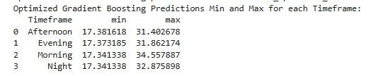
GRADIENT BOOSTING REGRESSION
Iterative, powerful for regression tasks but can be slow and sensitive to hyperparameter choices.
Typically needs large datasets for optimal performance.

Slide 29
DATA UNDERSTANDING FOR OPTIMIZATION
Identification of the factors determining Root Zone Temperature
RZT mainly depends on the Soil Temperatures at different depths.
-> SoilTemp_10cm
-> SoilTemp_20cm
-> SoilTemp_40cm
-> SoilTemp_80cm
Understanding the distribution of Soil Temperatures at various depths
-> 10 cm depth: Shows the highest temperature fluctuations.
-> 20 cm depth: Still variable but more stable than 10 cm, with slightly slower response to surface temperature shifts.
-> 40 cm depth: Exhibits reduced fluctuations, reflecting
seasonal trends with minimal daily variation.
-> 80 cm depth: Remains the most stable, with little day-to-day variation

Slide 30
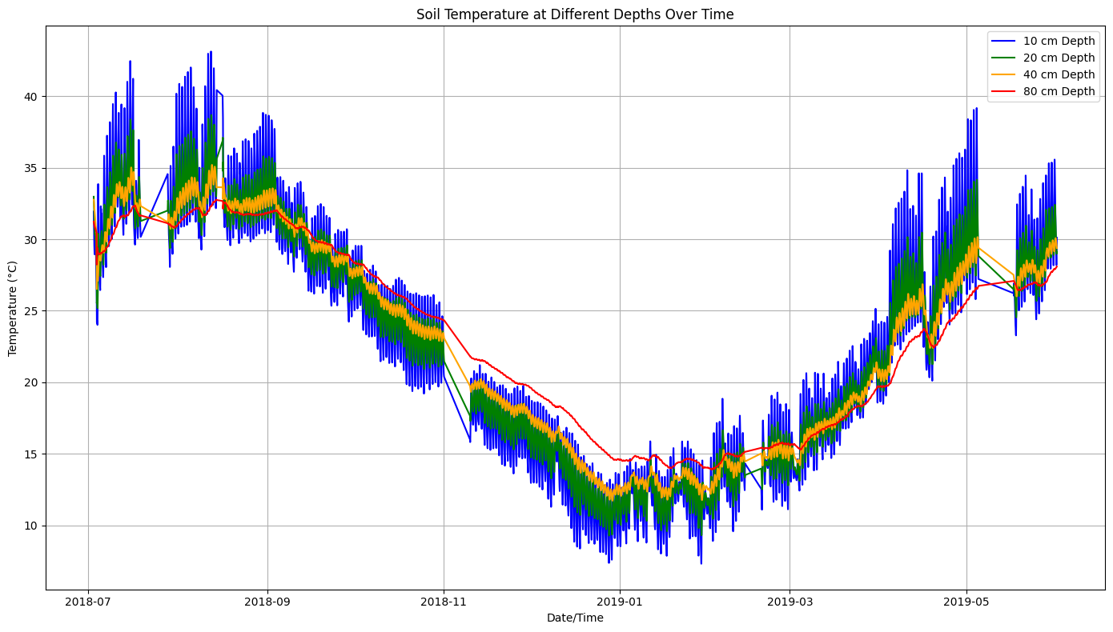
Plot showing the trend of Soil Temperatures at specific depths over Time (2018-2019)

Slide 31
EXPONENTIAL DECAY METHOD
Principle of Decay: The exponential decay method applies a decay constant α reducing influence as values get farther from a reference point. This approach prioritizes closer (or recent) data points, useful in contexts where influence fades with distance or time.
Normalization: To ensure weights sum to 1, each depth’s decay value is divided by the total decay values across all depths, ensuring a balanced influence across layers.
w i - Weight of the ith component
ɑ - Decay rate
d i - Depth of the ith component

Slide 32



WEIGHT DETERMINATION AND RZT EQUATIONS
Weight determination
w i - Weight of the ith component
ɑ - Decay rate
d i - Depth of the ith component
RootZone Temperature
SoilTemp i - Soil Temperature of the ith component
- Normalized weights

Slide 33
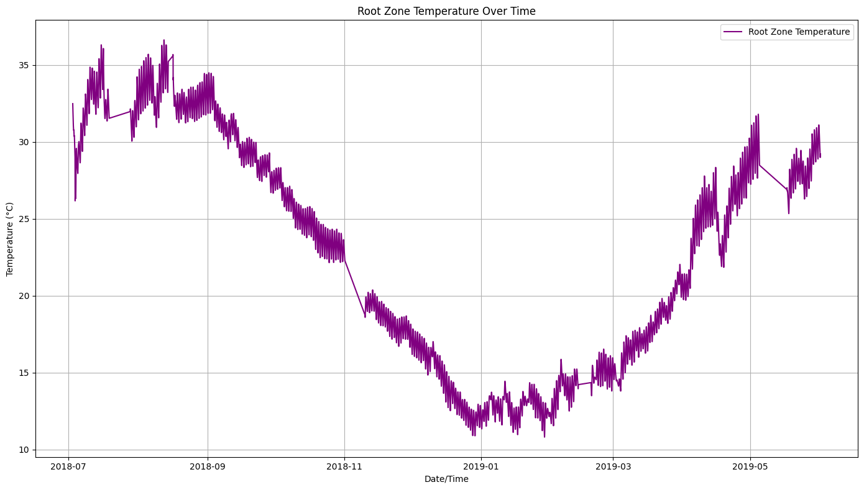
Determination and optimization of plant root zone temperature
Plot showing the trend of Root Zone Temperature over Time (2018-2019)

Slide 34
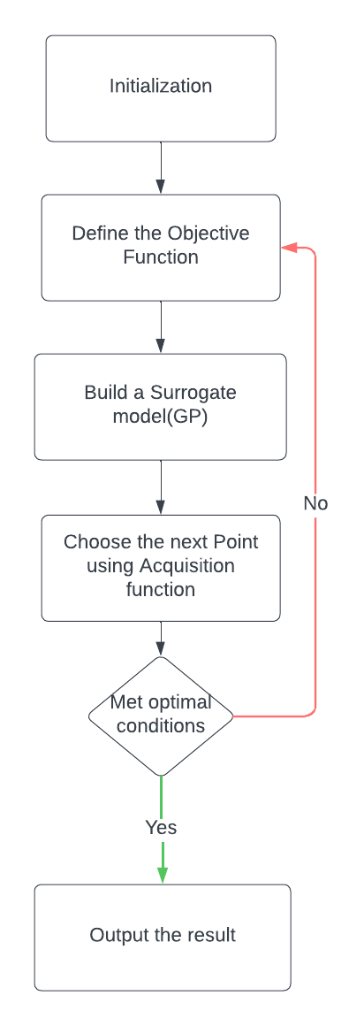
Flow diagram representing the working of Bayesian Optimization
The determination and optimization of root zone temperature is performed using the temporal forecasting results obtained from the TCN + ANN model.
Soil temperatures at depths of 10 cm, 20 cm, 40 cm, and 80 cm were weighted using an exponential decay formula.
It is based on the assumption that shallower depths have a larger influence on RZT. The weighted sum of soil temperatures was computed, yielding the RZT for each timestamp.

Slide 35
RESULTS OF OPTIMIZATION OF PLANT RZT
RMSE | 1.7582070426846619
MAE | 1.5220519743817684
MAPE | 0.07079311508752412
SMAPE | 0.07395064807160293
MAX ERROR | 3.4999488812673683
Percentage of values within the optimal range (18-25°C): 100.00%

Slide 36
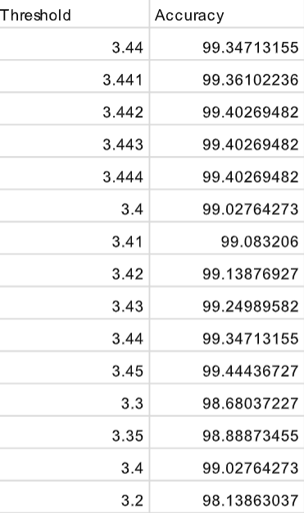
RESULTS OF OPTIMIZATION OF PLANT RZT
Highest Accuracy: 99.44% at threshold ±3.450°C

Slide 37
Before Optimization
Part of the Day | Min Value | Max Value
Afternoon | 17.25°C | 32.62°C
Evening | 17.26°C | 32.45°C
Morning | 17.24°C | 35.01°C
Night | 17.25°C | 33.31°C
After Optimization
Part of the Day | Min Value | Max Value
Afternoon | 18.00°C | 24.93°C
Evening | 18.00°C | 24.59°C
Morning | 18.01°C | 24.99°C
Night | 18.01°C | 24.08°C

Slide 38
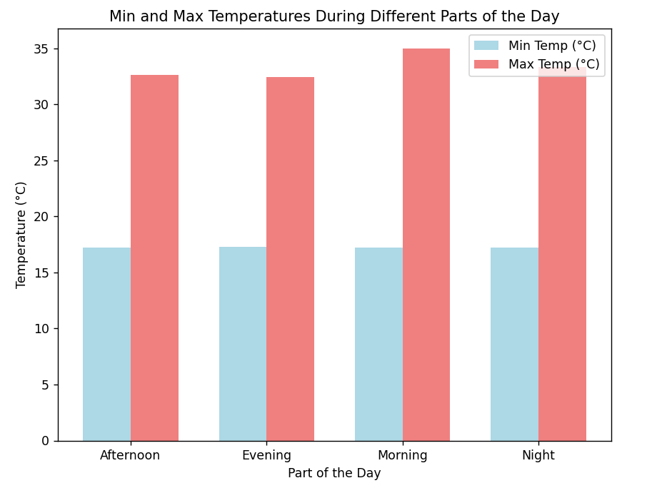
Before Optimization

Slide 39
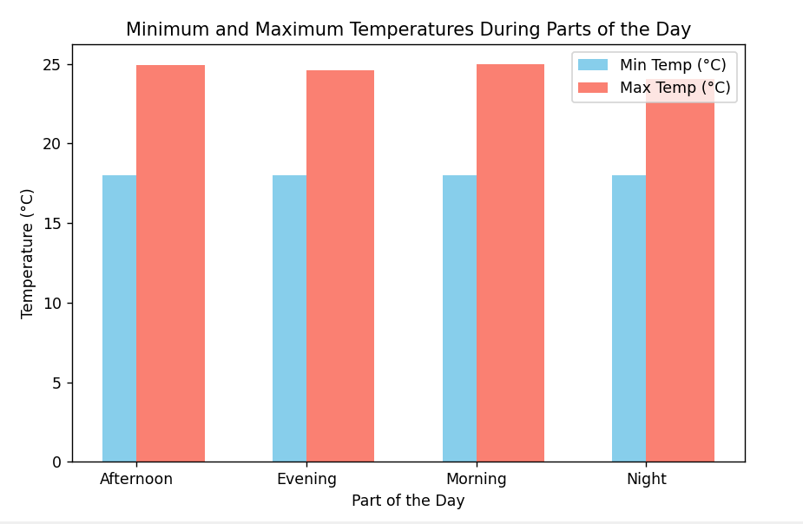
After Optimization

Slide 40
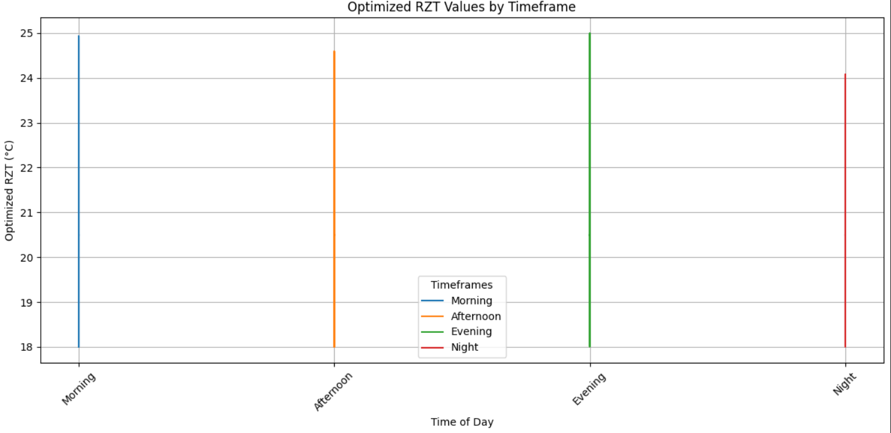
Plot showing the optimized values of the temperatures in four timeframes

Slide 41
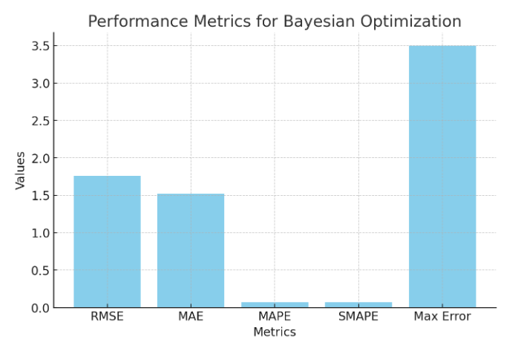

Slide 42
Thank you!

